Slide 1
FIRST CONDITIONAL +
FUTURE TIME CLAUSEs
Caterina Ines Latella

Slide 2
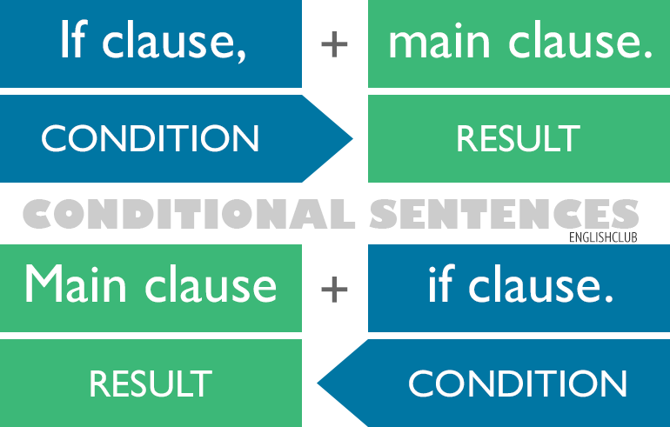
Conditional sentences?
CONDITION + CONSEQUENCE/RESULT
CONSEQUENCE/RESULT + CONDITION

Slide 3


SOME EXAMPLES
- If it rains, I will stay at home
“If it rains” is the CONDITION, and the RESULT/CONSEQUENCE is “I will stay at home”

Slide 4
FIRST CONDITIONAL sentence– WHAT IS IT?
We use first conditional sentences to talk about possible situations in the present or the future, things that may easily happen after a certain CONDITION.
If I see Sara, I’ll tell her to call you. (=possible)

Slide 5
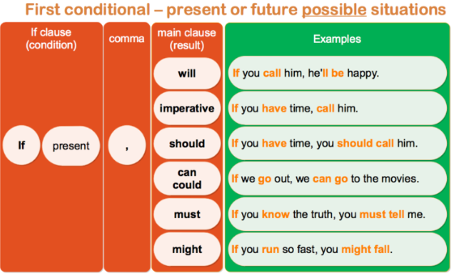
FIRST CONDITIONAL - TENSES
After the IF-CLAUSE we can use WILL/, imperatives / many modal verbs

Slide 6
Some practice
Complete the First Conditional sentences with the correct form of the verbs in brackets.
1. How often ______ people _______(work out) if they want to get into shape quickly?
2. If you________ (not want) to hurt yourself, warm up before exercising.
3. Tell me if something _______(hurt).
4. Working out ___________(not be) too bad if you have a good personal trainer.
5. If your arms ___________(be) weak, work with light weights at first.
6. __________(try) these weights if they aren’t too heavy for you.
7. We __________(strengthen) our muscles if we work with weights regularly.
8. If you _________ (get) bored on the treadmill, change your workout routine.
9. _________I ______(take) a break if I get really tired?
10. ___________(speak) to Mark if you want a good personal trainer!

Slide 7
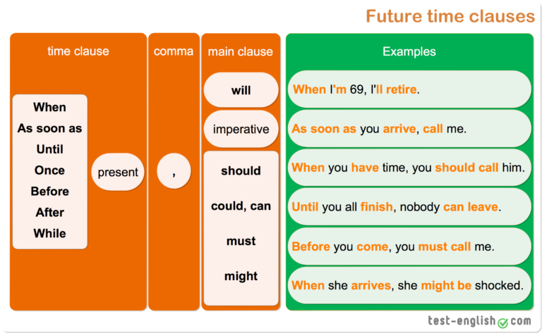
Future time clauses
The “IF” word can also be substituted by other words/expressions such as when, as soon as, until, once, before, etc…

Slide 8
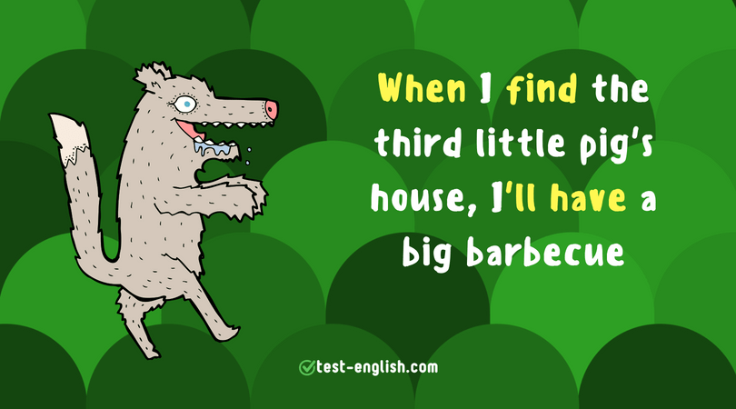
Future time clauses- EXAMPLES
I will buy some new clothes when I am in Milan
Unless* it rains, I will go out
*Unless= IF NOT
Once I finish this course, I will look for a job
As soon as I finish with this client, I’ll come and help you
Before the end of the year; I will have finished this course

Slide 9
Keep practicing
https://elt.oup.com/student/englishfile/intermediate/a_grammar/file04/nef_int_grammar04_a02?cc=gb&selLanguage=en
https://elt.oup.com/student/englishfile/intermediate/a_grammar/file04/nef_int_grammar04_01a?cc=gb&selLanguage=en
https://www.e-grammar.org/time-clauses/test1-exercise1/
https://learnenglish.britishcouncil.org/english-grammar/verbs-time-clauses-and-if-clauses (BRITISH COUNCIL- on first conditional and future time clauses + practice)

Slide 10

THANK YOU FOR YOUR attention

